Slide 1
CSF Shunts Gone BAD!
Brad Sobolewski, MD, MEd
Associate Professor
Assistant Director - Pediatric Residency Training Program
Division of Emergency Medicine
Cincinnati Children's Hospital Medical Center
bradsobolewski.com
@PEMTweets

Slide 2
Hydrocephalus

Slide 3
Hydrocephalus
Imbalance of absorption and production of CSF
Estimated incidence of 1/500-1000 children
125,000+ shunts
Either due to obstruction of CSF outflow, impaired reabsorption or excess production
Notes:
Excess CSF production is rare only really happens in cases of a functional choroid plexus papilloma

Slide 4
Obstructive hydrocephalus
The ventricular system is blocked and CSF accumulates proximal to the blockage
Communicating hydrocephalus
The subarachnoid system is blocked and CSF can’t be absorbed
The entire system fills with CSF
This is less common and due to IVH, Meningitis, Post-inflammatory scarring

Slide 5
Lateral
Lateral
Intraventricular foramina of Monro
Third
Cerebral aqueduct (of Sylvius)
4th
X2 Lateral foramina (Luschka)
Midline foramen (Magendie)
Cisterns/Subarachnoid Space
Notes:
STATS
Total volume 50ml
Production 20ml/hr
Turnover 3-4x/day

Slide 6
Etiology
Congenital
infection: Rubella, CMV, Toxo, Syphilis
X-Linked hydrocephalus stenosis of aqueduct of Sylvius
Acquired
Infection, trauma, tumors, head bleeds
Neural tube defects:
Associated with Chiari or aqueductal stenosis. Linked to teratogens and deficiency of folate.
Isolated
aqueductal stenosis (inflammation d/t intrauterine infection)

Slide 7
Chiari II
Often accompanies NTD
Brainstem and Cerebellum are displaced caudally

Slide 8
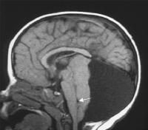
Dandy Walker
Large posterior fossa cyst continuous with 4th ventricle
Abnormal cerebellar development
Hydrocephalus in 70-90%

Slide 9
Presenting symptoms of hydrocephalus
Headache
Vomiting: increased ICP in the posterior fossa
Behavioral changes
Drowsiness: midbrain/brainstem dysfunction
Visual changes: Optic Nerve compression
Incoordination
Loss of developmental milestones
Head circumference increases rapidly
“Sunsetting“ eyes: fixed downward gaze
Notes:
Pro-Tip: These symptoms obviously vary based on the age of the patient

Slide 10
Shunts

Slide 11
Shunt devices
Proximal portion is placed in a ventricle (usually the right)
Could also be in an intracranial cyst or lumbar subarachnoid space
Distal portion
Internalized: peritoneum, pleura, atrium
Externalized
EVD: Acute hydrocephalus for pressure monitoring, infected shunt
Ommaya reservoir: Generally for administration of drugs (antibiotics or chemo)

Slide 12
Ventricular Catheter
Valve
Distal Catheter

Slide 15
Complications
Infection
Malfunction
Over drainage
Under drainage
Subdural hematoma
Multiloculated hydrocephalus
Seizures
Notes:
Over drainage causes the ventricles to decrease in size creating slit-like ventricles as a result of the brain and its meninges pulling away from the skull. Slit-like ventricles, sometimes called slit-ventricle syndrome (SVS), are most commonly a problem in young adults who have been shunted since childhood. A particular symptom of SVS is severe intermittent headaches that are often relieved when lying down. Imaging studies are required to determine SVS, which is typically indicated by smaller than normal ventricles. Most shunt manufacturers have shunt hardware designed to address slit-ventricle syndrome.
Under drainage causes the ventricles to increase in size and can fail to relieve the symptoms of hydrocephalus. To restore a balanced flow of CSF it may be necessary to place a new shunt with a more accurate pressure valve. For those who have externally adjustable or programmable valves, the balance of flow can be restored by re-setting the opening pressure.
Subdural hematoma occurs if blood from broken vessels in the meninges becomes trapped between the brain and skull. This is most common in older adults with normal pressure hydrocephalus (NPH) and requires surgery to correct.
Multiloculated hydrocephalus is a located (isolated) CSF compartment in the ventricular system that is enlarged and not in communication with the normal ventricle. It may be caused by birth trauma, neonatal intraventricular hemorrhage, ventriculitis, shunt related infection, over drainage or other conditions. This complication may be difficult to identify because it is typically seen in infants and children who may be neurologically compromised. Surgical treatments include multiple shunt placement, ventricular catheters with multiple perforations or openings, craniotomy and fenestration (opening) of the intraventricular loculations.
Seizures sometimes occur in people with hydrocephalus. There is no correlation between the number of shunt revisions or the site of shunt placement and an increased risk of developing seizures. Past studies have shown that children with hydrocephalus who have been treated with a shunt and who also have significant cognitive delay or motor disability are more likely to experience seizures than those without cognitive or motor delays. Studies have also indicated that seizures are not likely to occur at the time of shunt malfunction, and that the most likely explanation of seizure disorder is the presence of associated malformations of the cerebral cortex.
Abdominal complications can occur in people with hydrocephalus treated with a shunt. The peritoneum or abdominal area is the most popular site for distal catheter implantation. Although ventriculoperitoneal (VP) shunts do not have fewer complications than ventriculoatrial shunts, the complications are less severe and have a lower mortality rate. Shunt complications that develop in the peritoneum or abdominal area include peritoneal pseudocysts, lost distal catheters, bowel perforations and hernias.

Slide 16
Shunt Infections

Slide 17
Infection
5-15% overall risk
Fever is variably present, and meningeal signs are not correlative
Ventriculoperitoneal shunt infections can also present with GI Sx/peritonitis
VA shunts with endocarditis
Notes:
Doesn't connect with the meninges

Slide 18
Shunt infections are more likely in the first month after placement
Notes:
Doesn't connect with the meninges

Slide 19
Infection
Younger age
Previous shunt infection
Certain causes of hydrocephalus (more likely after purulent meningitis, hemorrhage, or myelomeningocele)
Shunt revision - especially ≥3 revisions
Risk factors

Slide 20
Infection
Less experienced neurosurgeon
More people in the OR
Use of a neuroendoscope
Longer duration of the shunt procedure
For VA shunts insertion of the catheter below T7 vertebral body
Skin preparation/shaving of skin
Risk factors

Slide 21
Infection
External Ventricular Drain risk is up to 1 in 5
10.6 infections per 1000 catheter days
Risk greatest if in place >5 days
EVD

Slide 22
Infection
Usually due to skin flora or more rarely hematogenous spread
50% Coag negative Staph - ⅓ of Staph is Staph aureus
Cutibacterium [FKA Propionibacterium] acnes and Corynebacterium jeikeium
Notes:
Doesn't connect with the meninges

Slide 23
Infection
Most come from the proximal end
Distal site infections are a result of contamination from peritonitis
Gram negatives, Pseudomonas, Streptococci, anaerobes are rare in kids
Notes:
Doesn't connect with the meninges

Slide 24
Infection
Diagnosis requires an organism cultured from the CSF
OR
>1 year of age ≥2 of…
Fever, headache, meningeal signs, or cranial nerve signs
≤1 year of age: ≥2 of…
Fever >38°C or hypothermia <36°C, apnea, bradycardia, or irritability and at ≥1 of…
Increased CSF white blood cell count, elevated CSF protein, and decreased CSF glucose
Organisms seen on a CSF Gram stain
Organisms cultured from the blood
Positive nonculture diagnostic test from the CSF, blood, or urine
Notes:
Doesn't connect with the meninges

Slide 25
Infection
CSF is better obtained via shunt tap
CT or MRI should be performed
Abdominal U/S if the child has GI Sx (looking for pseudocyst)

Slide 26
Infection
Treatment
Device removal and external drainage with replacement once CSF is sterile for ≥48 hours
Parenteral antibiotics for 10-14 days
Empiric Vanc + cefotaxime/ceftriaxone
Notes:
No RCTs
Bugs can Create a biofilm on equipment
You don’t need a period off abx to replace shunt
Equipment should be antibiotic impregnated

Slide 27
Shunt Malfunctions

Slide 28
Shunt malfunctions are usually due to mechanical failure

Slide 29
Malfunction
Majority of 1st failures are due to obstruction at the ventricular catheter
Shunt over drains
Ventricles shrink
Tip gets clogged against choroid plexus
Other causes include shunt migration and excessive CSF drainage
15% due to fractured tubing

Slide 30
Shunt malfunctions need to be recognized quickly and managed in the operating room

Slide 31
Malfunction
Median survival of a shunt (before need for revision)
≤2 years old = 2 years
≥2 years old = 8 to 10 years

Slide 32
Malfunction
A decision rule was developed - Peds Emerg Care, 2008
Sign/Symptom | +LR | -LR
Bulging fontanel | 44.6 | 1.84
Irritability | 13.7 | 1.75
Nausea/Vomiting | 11.1 | 1.58
Accelerated head growth | 6.02 | 1.86
Headache | 4.28 | 1.22
Notes:
647 visits to the ED
78% younger than age 1 at time of insertion of shunt
children older than 2 months with none of the following predictors as low risk for ventricular shunt malfunction: irritability, nausea or vomiting and headache.
38% failure rate at 3 years, 8.5% by infection
Built a decision tree model

Slide 33
Malfunction
Children with a shunt malfunction were less likely to present with…
Fever
Seizure
History of multiple prior revisions was also associated with risk for shunt malfunction

Slide 34
Malfunction
Validation of the previous decision rule
146/755 ED visits for 294 kids had a shunt malfunction (19%; 95% CI, 17%–22%)
Children with a ventricular shunt malfunction were more likely to present with…
Headache
Nausea and/or vomiting
Bradycardia
Mental status change
Boyle et al. Pediatric Emerg Care, 2017

Slide 35
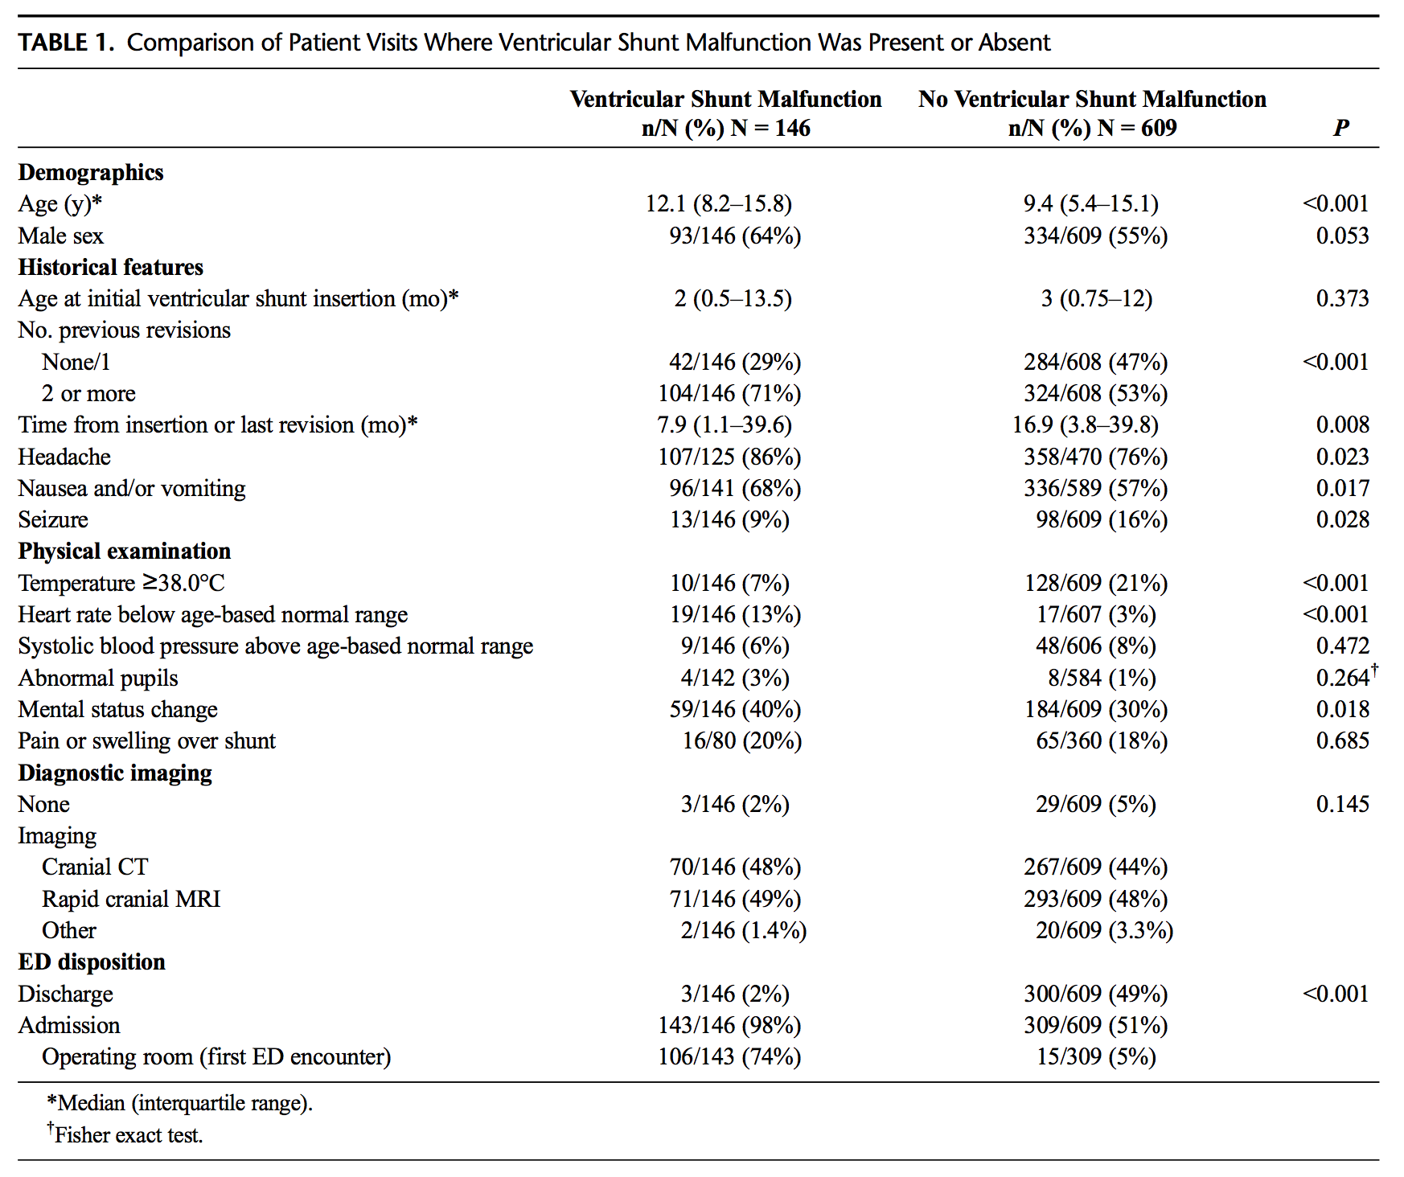

Slide 36
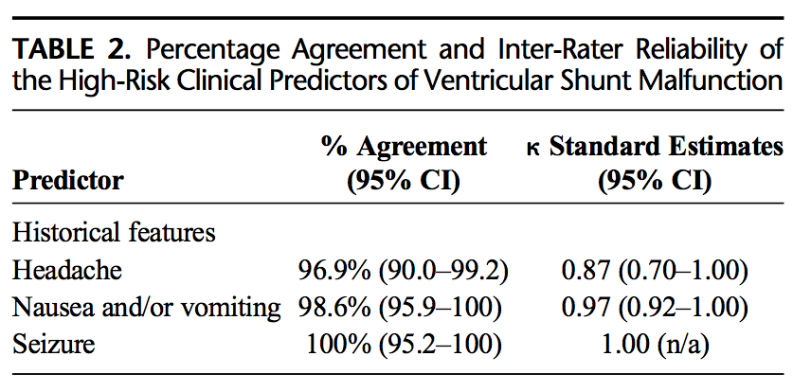
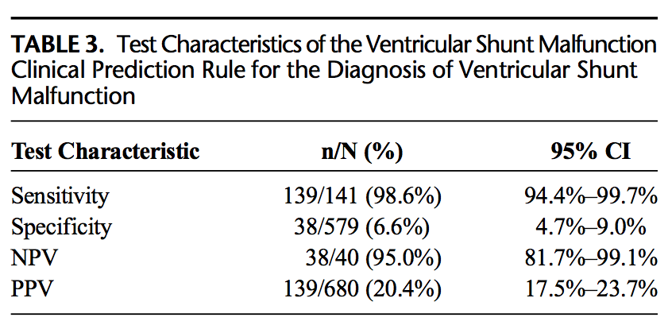

Slide 37
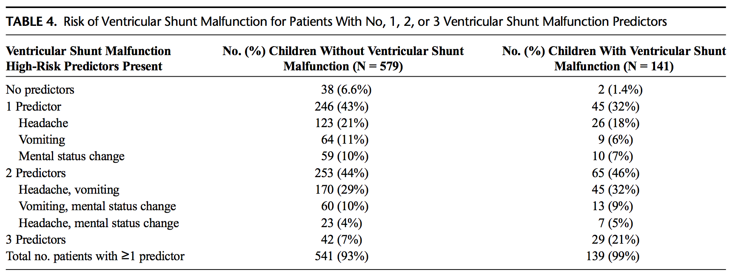

Slide 38
Malfunction
Riva-Cambrin et al, 2017 also looked at risk factors for malfunction in a multi-center prospective cohort
344/1036 experienced shunt failure, including 265 malfunctions and 79 infections
Three factors were were independently associated with reduced shunt survival
Age younger than 6 months at shunt placement (HR 1.6 [95% CI 1.1–2.1])
Cardiac comorbidity (HR 1.4 [95% CI 1.0–2.1])
Endoscopic placement (HR 1.9 [95% CI 1.2–2.9])
No independent associations with shunt survival
Etiology
Where the surgery was done
Valve design
Use of ultrasound or stereotactic guidance
Surgeon experience and volume

Slide 39
Malfunction
Workup includes head CT and shunt series + Neurosurgery consult

Slide 40
Malfunction
Shunt series
Radiographs of the skull, neck, chest, and abdomen
Look for mechanical breaks, kinks, and disconnections in the shunt - most common in the neck

Slide 41
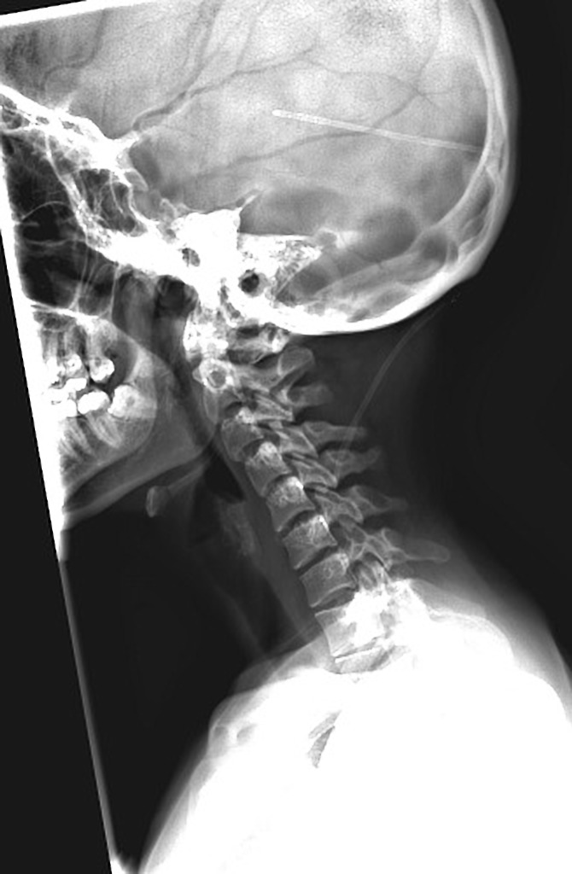
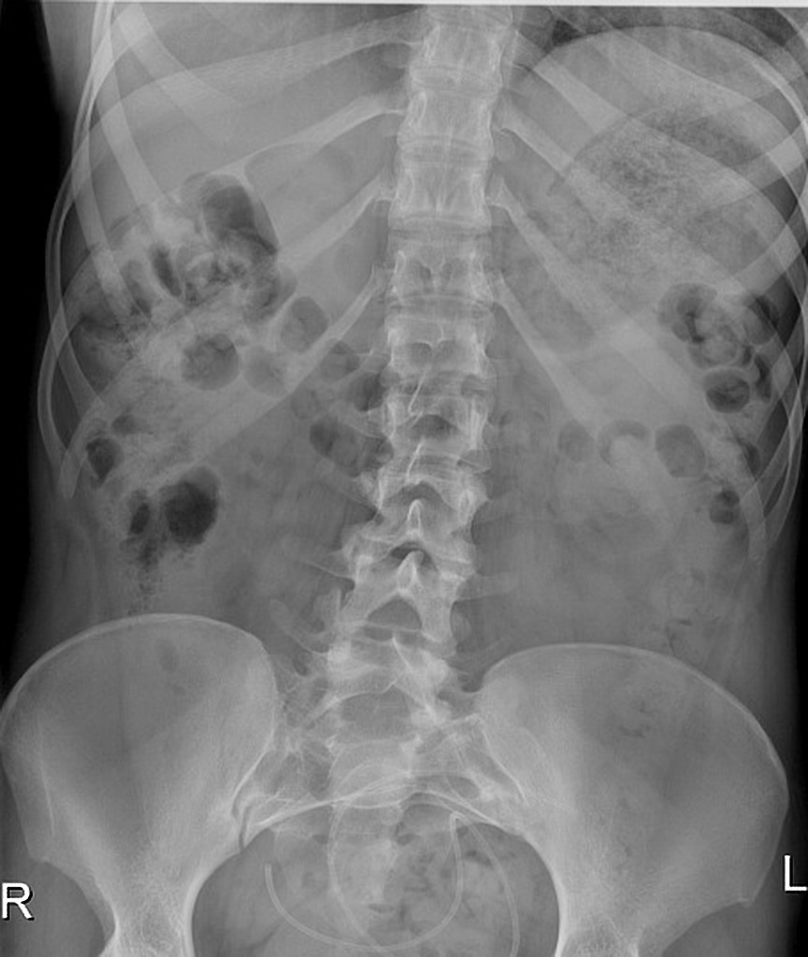
From Radiopedia
The VP shunt on the right side of the neck, seen best on the lateral neck/skull and AP neck views appears discontinuous. The shunt is not seen on the chest or abdominal wall with the remainder of the tubing is noted coiled in the abdomen.

Slide 42
Malfunction
Pitetti, Pediatr Emerg Care, 2007 – Retrospective review of 291 kids (461 ED visits)
78% had a shunt series
15% (71/291) Dx with malfunction
22 of these 71 had a normal head CT
6 of these 22 had an abnormal shunt series

Slide 43
Malfunction
Head CT
Not always diagnostic - sensitivity 54-83%
Size of ventricles can help, but in up to ⅓ of cases of shunt malfunction the CT is nondiagnostic (especially Chiari II/MM)

Slide 45
Malfunction
Zorc, 2002

Slide 46
Malfunction
MRI
May replace CT
Protocols exist for fast MRI scans

Slide 47
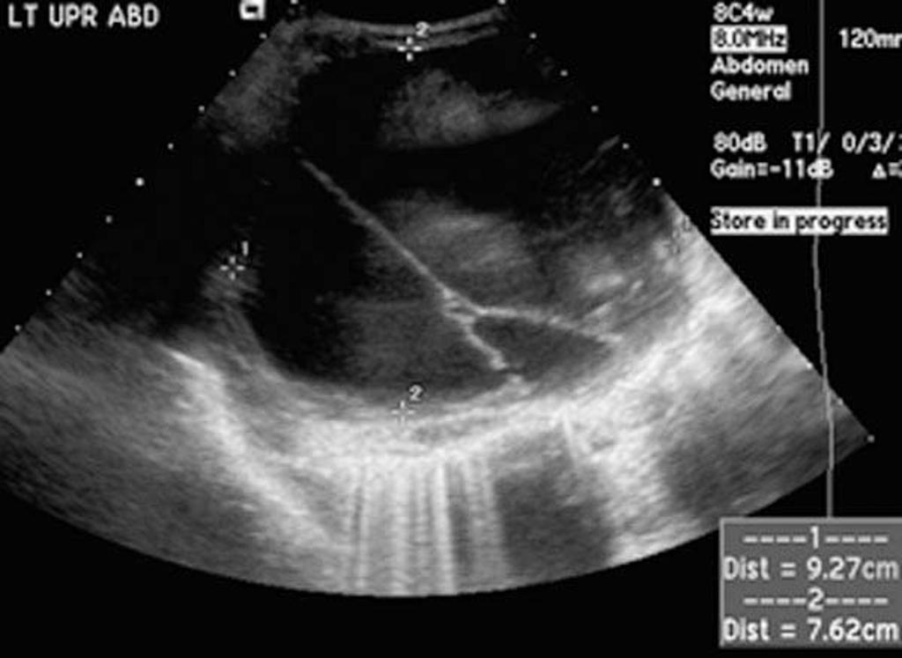
Malfunction
Abdominal Ultrasound
A pseudocyst is a false pocket in the abdomen at the distal end of the shunt
Fluid collects and may cause obstruction
Consider in patients with GI symptoms and concern for shunt malfunction, but usually obtained at discretion of Neurosurgeon

Slide 48
Malfunction
Shunt Tap?
Opening pressure >25cm H₂O associated with distal obstruction in 90%
Poor flow associated with proximal shunt in >90%
Notes:
23 or 25G butterfly needle inserted into reservoir at site of valve

Slide 49
Malfunction
Shunt Tap?
Contraindications
Skin infection over shunt site
Coagulopathy
Lack of shunt imaging/info

Slide 50
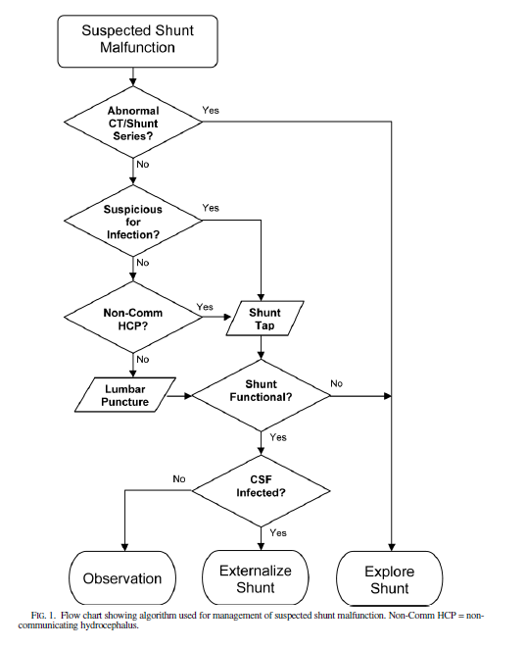
Miller, J. Neurosurg Pediatrics 2008

Slide 51
Malfunction
ABCs
Head midline, elevated 30 degrees
Manage hypoxia (sats >95%), hypercarbia , hypotension, and hypoglycemia
Temperature control
Mild sedation (don’t cause hypotension)
Control severe shivering w/ paralytics
Prophylactic AEDs to patients at risk for seizures
3% Saline/Mannitol

Slide 52
No intervention is more important than a trip to the OR in shunt malfunctions!

Slide 53
Take Home Points

Slide 54
Shunts infections are far more common in the initial month after placement

Slide 55
Shunt malfunctions are usually mechanical, and proximal

Slide 56
Get a head CT and shunt series unless you can find another cause for the child’s symptoms

